Slide 1

THE DECIDERS

Slide 2

Introducing the all new
ALUM
CONNECT
www.alum-connect.com

Slide 3



A SEPARATE ENVIRONMENT FOR
ALUMNI, STUDENTS AND UNIVERSITIES

Slide 4
HOW DO WE HELP?
01
02
03
A university can create their separate page
Alumni of the respective colleges can join to these pages!
Students get daily updates and exciting job opportunities!
Alum-Connect provides a isolated environment facility to the respective colleges to keep a track of their alumni and students allowing alumni to post exciting job opportunities for the students!

Slide 5
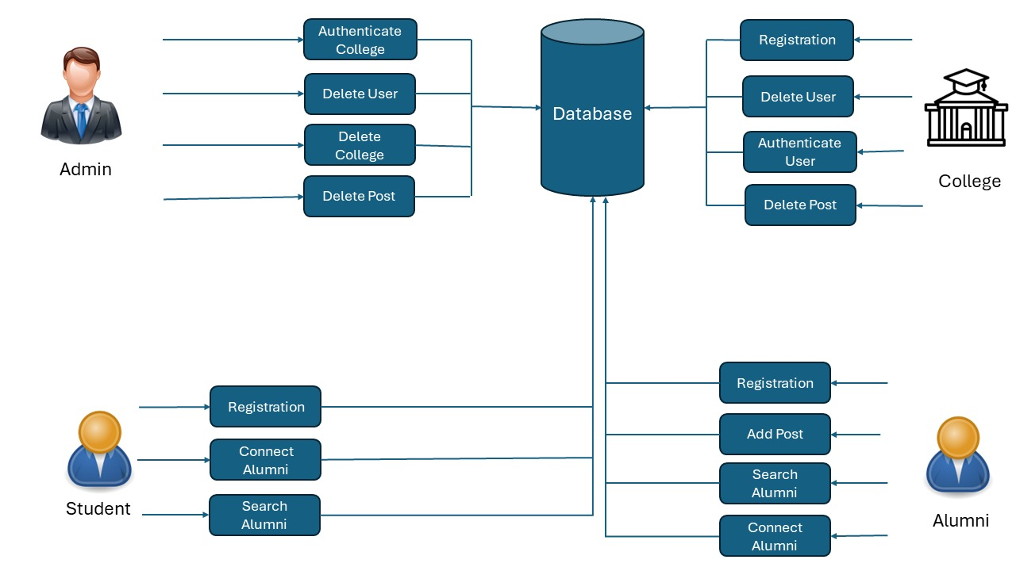
THE
ARCHITECTURE

Slide 6
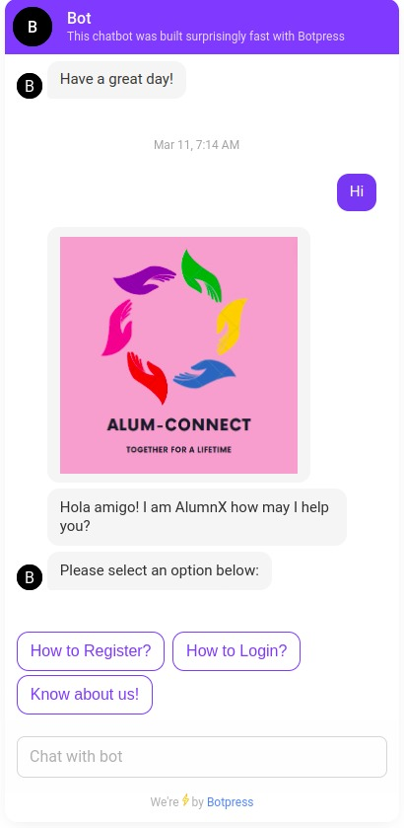
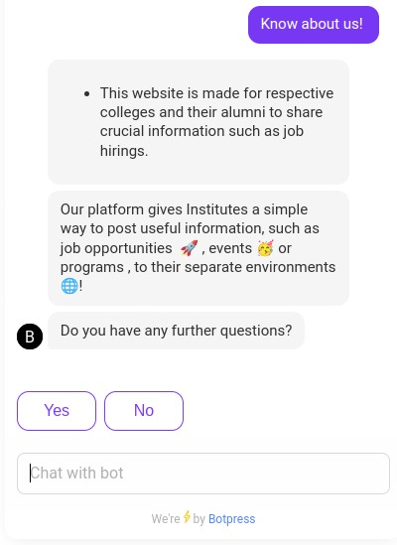
ALUMNX
THE CHAT BOT
an AI chat bot based on NLP and AI methodologies to help and understand you!

Slide 7
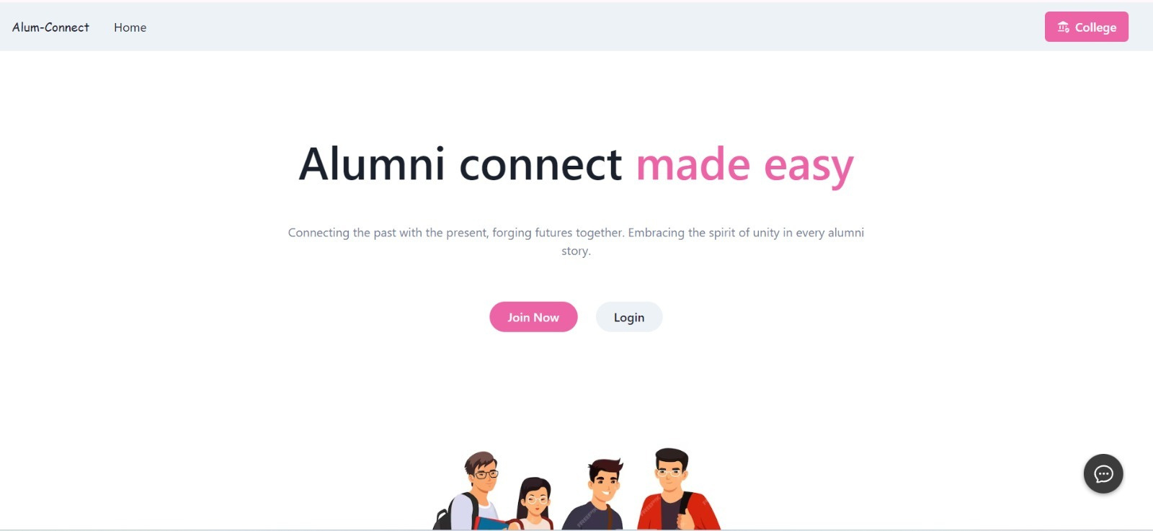
MINIMILASTIC DESIGNS

Slide 8
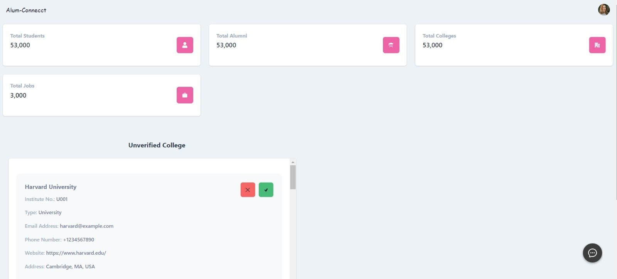
THE FEATURES!

Slide 9
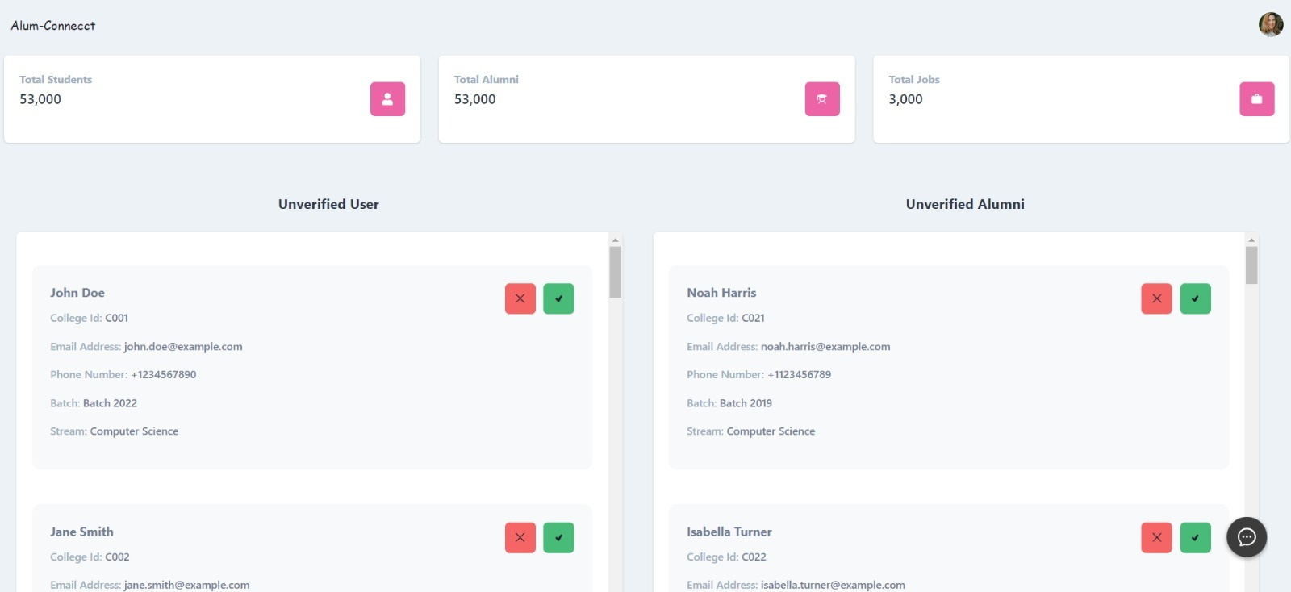
ADDITIONAL FEATURES

Slide 10
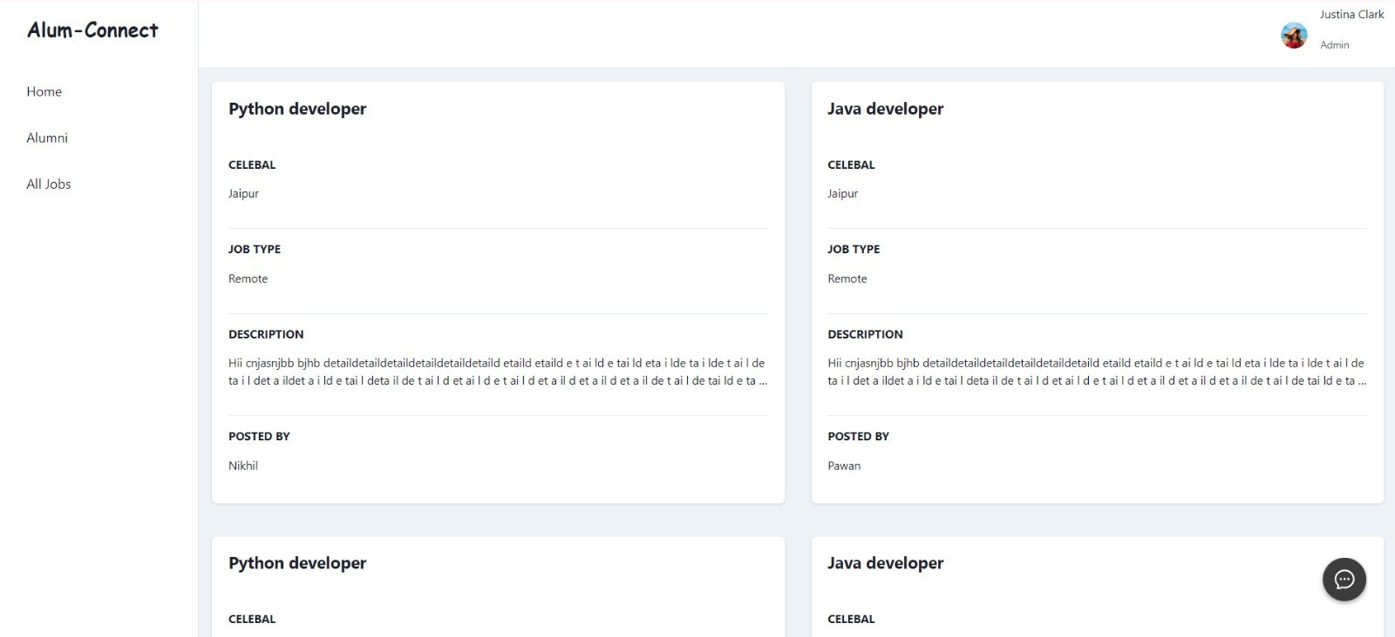
THE JOB PAGE

Slide 11
THANK YOU
FOR YOUR ATTENTION

